Slide 1
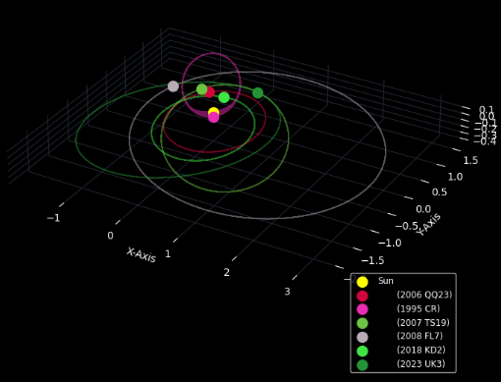
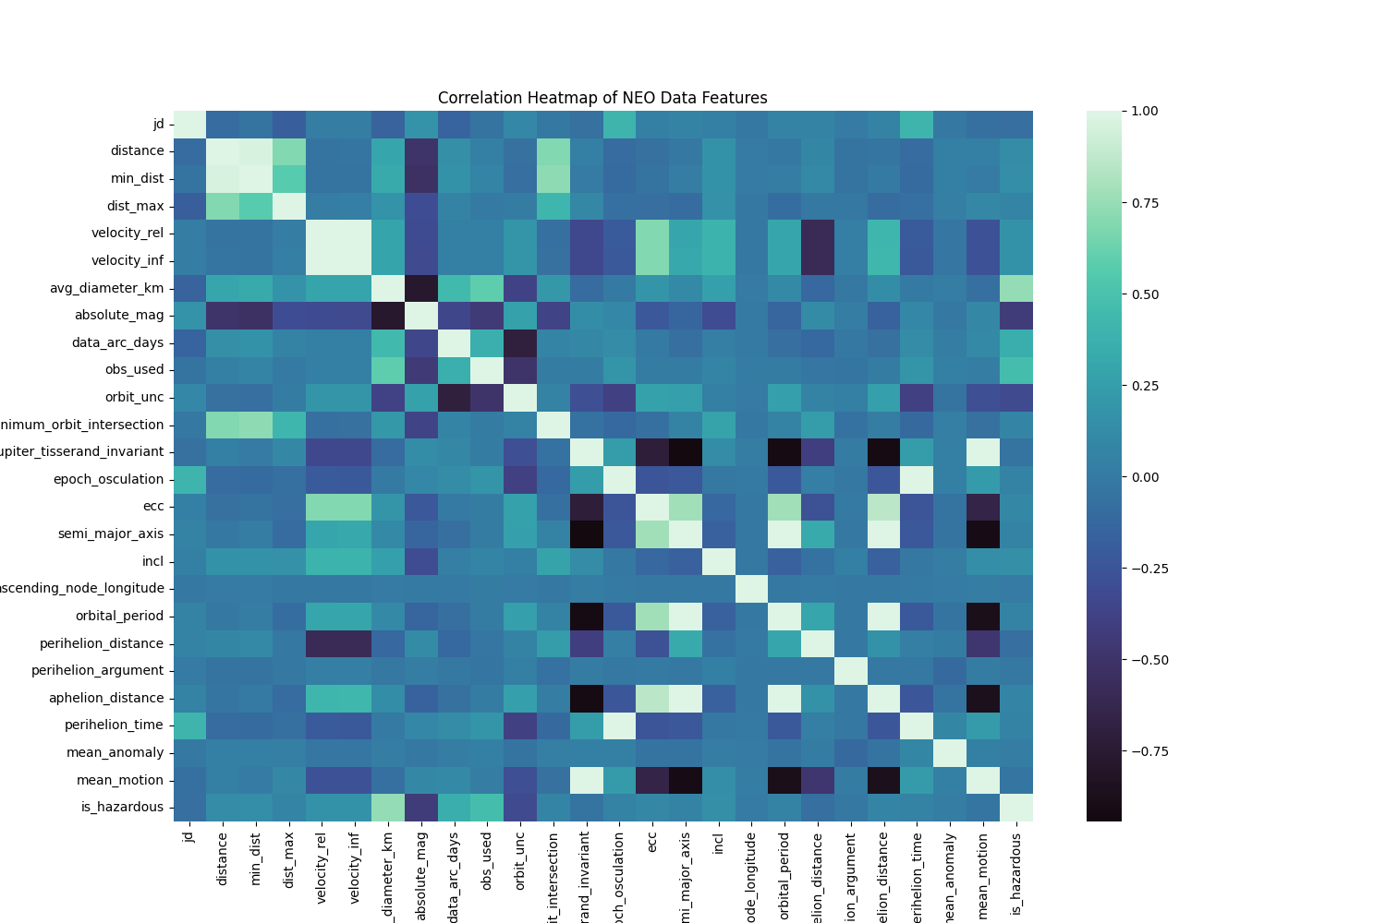
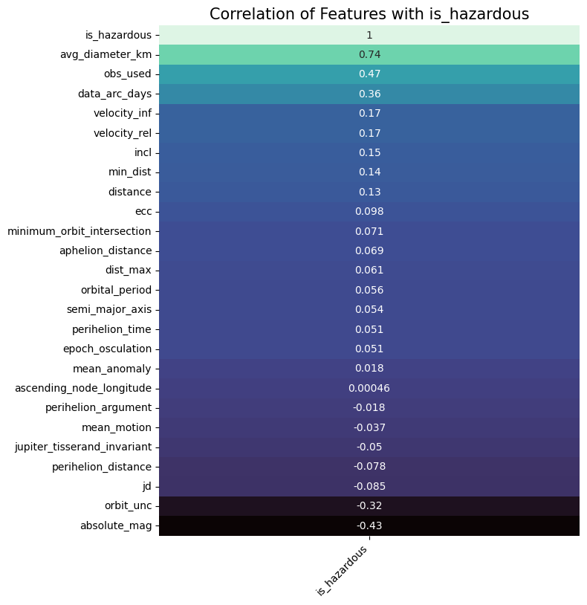
HEADER
Body TExt
PROOF OF CONCEPT/
EXPERIMENT/SIMULATION
HEADER
Body Text
HEADER
Body Text

Slide 2
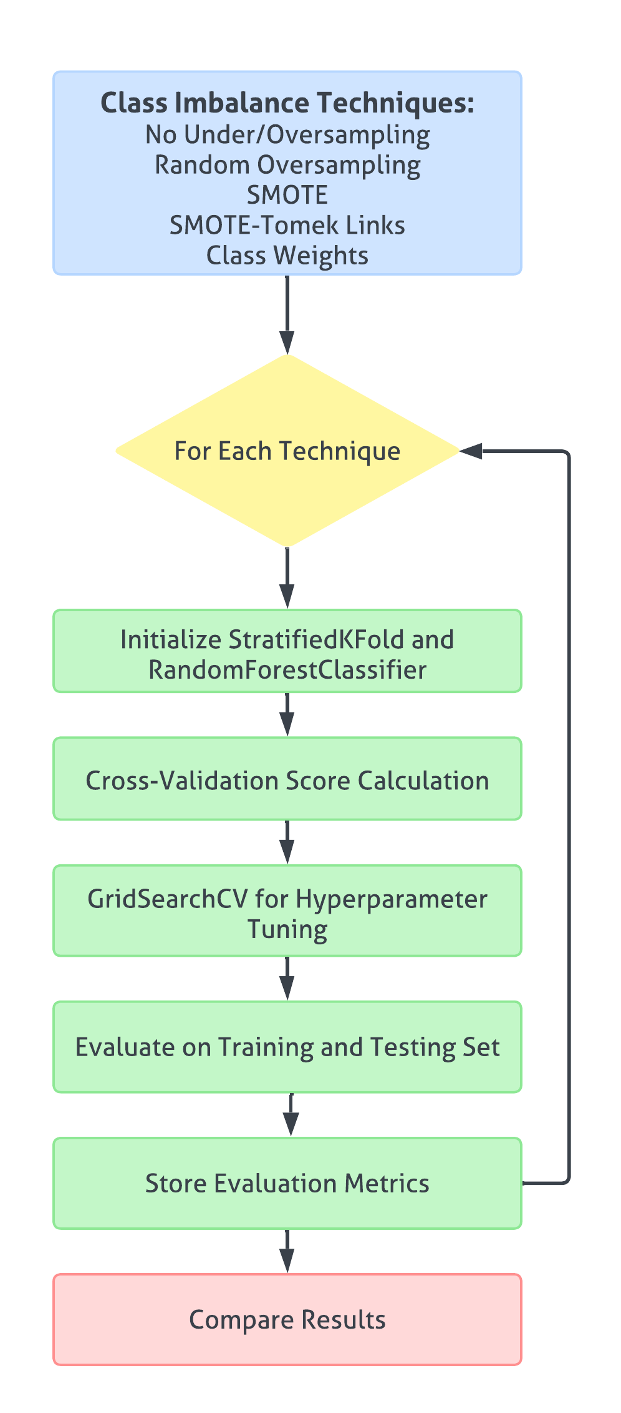
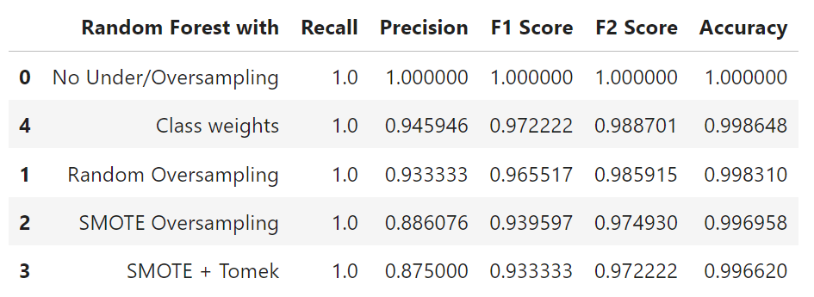
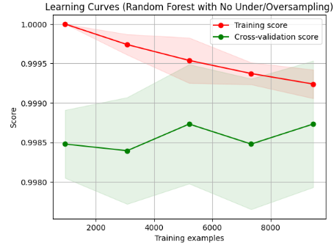
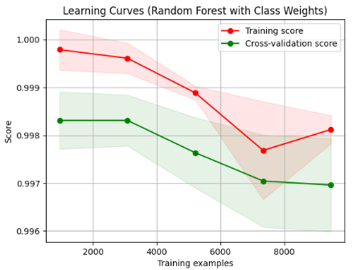
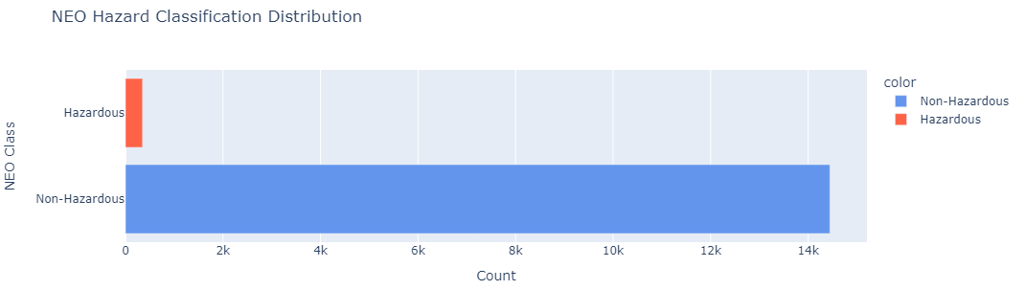
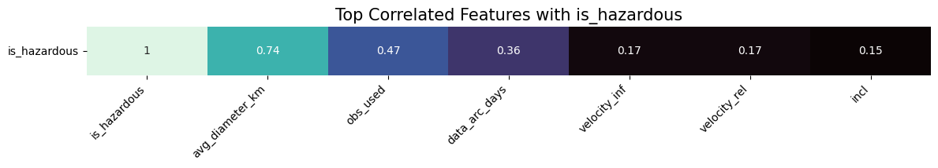
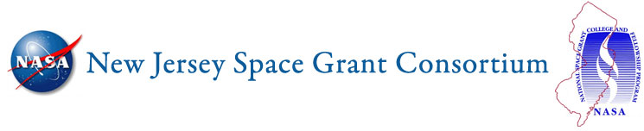
Predicting Hazardous Near-Earth Objects
with Random-Forest and Class Imbalance Techniques
Nataly Jimenez Cruz, Advised by Dr. Kevin Lu
Department of Computer Science, Stevens Institute of Technology, Hoboken, NJ
Introduction
Near-Earth Objects (NEOs) are comets and asteroids with orbits that bring them close to Earth’s vicinity. These celestial objects can pose potential threats to Earth and are known as Potentially Hazardous Asteroids (PHAs). The primary objective of this research is to develop a machine learning model that accurately classifies NEOs as hazardous or non-hazardous. Accurate predictions allow for effective responses to potential threats and impact mitigation strategies. A significant challenge was dealing with a highly imbalanced dataset, where the ‘Non-Hazardous’ class vastly outnumbered the ‘Hazardous’ class. This necessitated the use of specialized techniques and metrics to handle imbalanced data.
Model Development
Results
Five models were trained and tested using the Random Forest algorithm with four models using distinct class imbalance techniques and one model with no class imbalance techniques applied, serving as a baseline model.
One other technique was discussed but not further evaluated for training or testing. The make_pipeline() method was used to streamline multiple data transformation and training steps
The table below shows the results from each model. While the Random Forest with No Under/Oversampling shows perfect scores, the model is overfitting due to the class imbalance, making it less reliable for generalization. The Random Forest using Class Weights model provides the most balanced approach with a high recall and good precision, making it effective for identifying hazardous cases with minimal false positives.
Learning curves for each model were used to visualize how the model is performing as data grows. A large gap between the training and validation curve could mean overfitting or the model is too complex. It is notable that there is a large gap between the two scores in No Under/Oversampling, whereas Class Weight’s gap is smaller.
Data Extraction and Pre-Processing
The dataset was curated extracting data from the Small-Body Database (SBDB) Close-Approach Data API for dates between January 1, 2004 and June 1, 2024 and one of NASA’s Open APIs, Asteroids – Near Earth Object Web Service (NeoWs). The result from the data extraction phase was a dataset containing 15,355 rows of NEOs, 31 columns of features and 1 label, ‘is_potentially_hazardous_asteroid’. Multiple data pre-processing techniques were applied such as dropping rows with missing values and columns irrelevant for prediction, feature scaling, label encoding, and creating heatmaps to visualize features correlated to the label.
Due to the significant class imbalance and importance of identifying hazardous objects, F2 (F-beta) measures were the most important measures used to evaluate the models.

